Slide 1
Association of Arctic Expedition Cruise Operators
Supporting an HFO ban in the Arctic
Troels Jacobsen
aeco.no

Slide 2
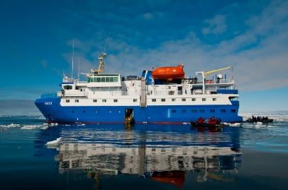
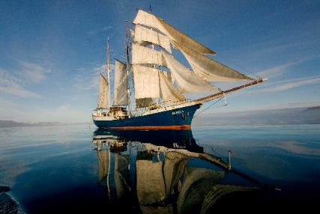
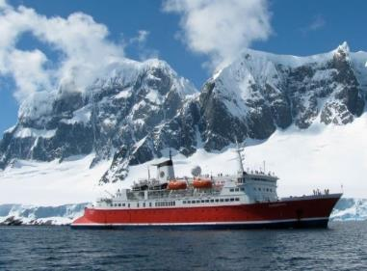
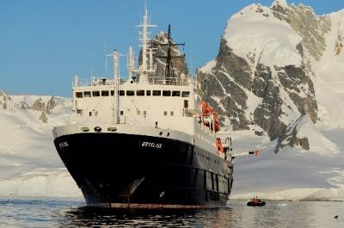
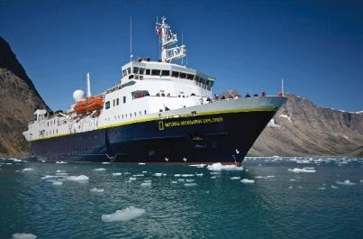
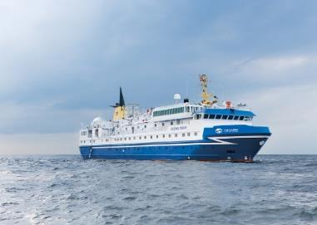
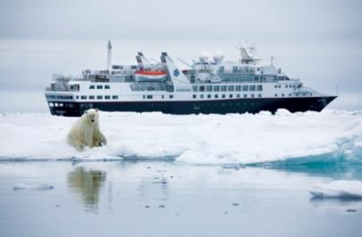
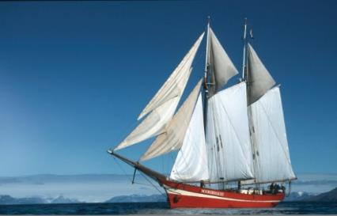
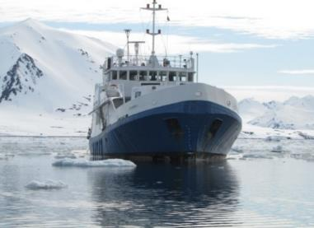
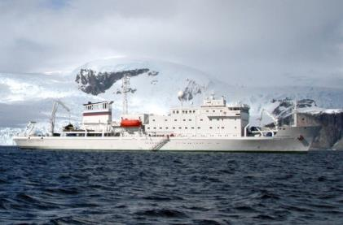
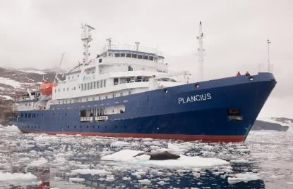
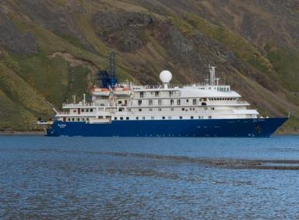
Who are we?
76 international members
41 operating vessels (2019)
30 new vessels in the next 5 years
Ensure environmentally friendly, responsible and safe cruise tourism in the Arctic
Advocate for the expedition cruise industry and AECO’s members’ interests
Notes:
The Association of Arctic Expedition Cruise Operators' role is to ensure that expedition cruises and tourism in the Arctic is carried out with the utmost consideration for the vulnerable, natural environment, local cultures and cultural remains, as well as the challenging safety hazards at sea and on land.
AECO also represents the concerns and views of the expedition cruise tourism companies operating in the Arctic.
AECO’s members include vessel operators, owners, hotel management companies, but also affiliate companies with interest in the industry.

Slide 3
Notes:
Represent a majority of the exediton cruise industry in the Arctic

Slide 5
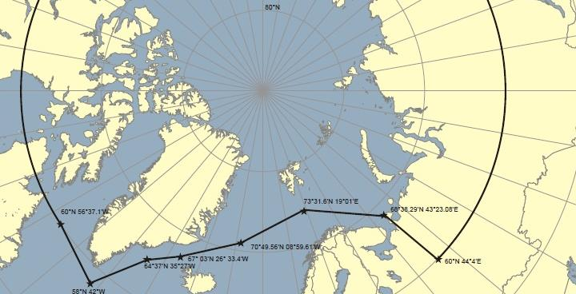

Slide 6
AECO’s standards and guidelines
AECO’s members decide which guidelines and standards should be made mandatory during AECO’s Annual Meeting
Notes:
Backbone of what AECO does. Working with guidelines which are sometimes stricter than regulations

Slide 7
Cruise Industry HFO Timeline
THE CLEAN ARCTIC ALLIANCE
HFO ban in most protected areas of Svalbard &
AECO’s first operational guidelines related to fuel use
AECO signs the Arctic Commitment at Arctic Frontier
HFO ban expansion in Svalbard
2007
2015
2017
2011
2016
2019
HFO ban in Antarctica
AECO supports international ban on HFO for all ship traffic in the Arctic
AECO formally approved a self-imposed ban on the use and carriage of HFO
Notes:
AECO is strengthening its positions as one of the world’s largest cruise organizations and reaffirming the expedition cruise industry’s commitment to responsible tourism.
By formalizing this ban, the expedition cruise industry is sending a message to decision-makers that it is time to act to protect the Arctic from the risk of HFO pollution

Slide 8
Expedition cruise industry drivers
THE CLEAN ARCTIC ALLIANCE
Clients demand for pristine environment
Potential oil spill could be devastating for operations in affected area for considerable time
Part of AECO objectives to conduct “environmentally friendly” tourism

Slide 9
Level playing field
THE CLEAN ARCTIC ALLIANCE
AECO support a level playing field:
Within expedition cruise industry
1) No patchwork of regional regulations making it
easier to operate across different Arctic Regions
Between different industries
2) Oil spills could have devastating effect on industry
3) Core business depends on long term sustainability –
also from others

Slide 10
www.aeco.no
@ArcticCruiseOperators
@ArcticCruiseOp
Notes:
Thank you.

