Slide 1
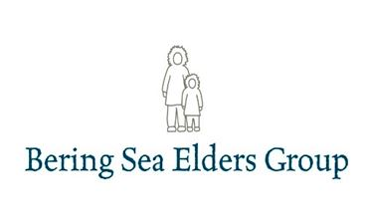

Slide 2
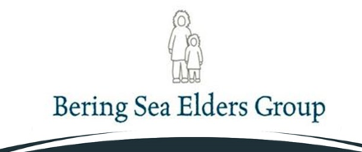
Mission
To speak and work together as one voice to protect and respect our traditional ways of life, the ocean web of life that supports the resources we rely on, and our children’s future.

Slide 3
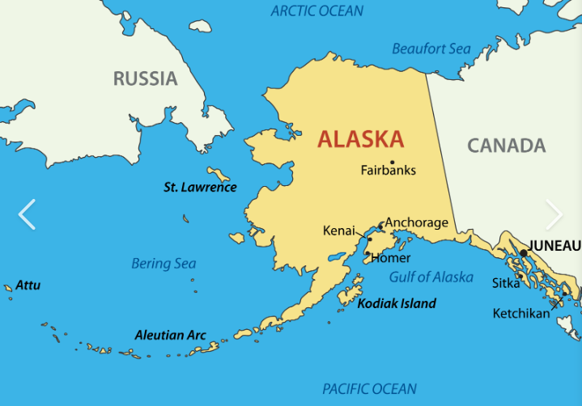
Map accessed 9.25.2020 from fotolip.com

Slide 4
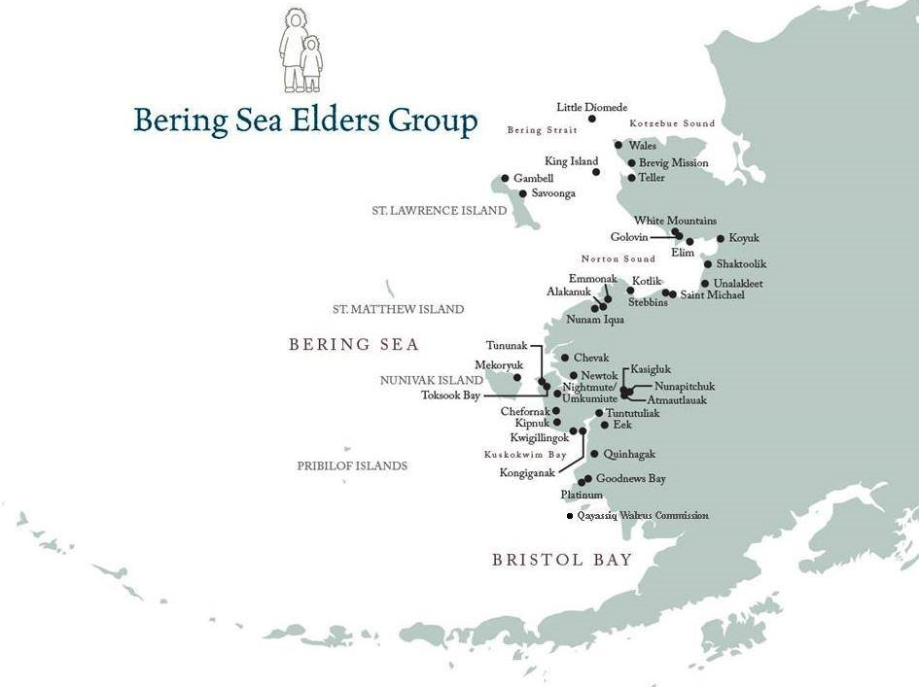
Notes:
The Bering Sea Elders Group (BSEG) formed in late 2007 to unify traditional indigenous leadership and foster collaboration between Tribes across two large regions of the Bering Sea in Alaska - the Yukon-Kuskokwim Delta and Bering Strait. BSEG was organized to be an outward and collective expression of traditional indigenous leadership. It is the view of the Elders that today's challenges require that Tribes collaborate with each other - as one mind and one voice - to successfully protect our customary and traditional ways of life, hunting fishing, harvesting, and gathering, and guide our decisions that affect our future generations.

Slide 5
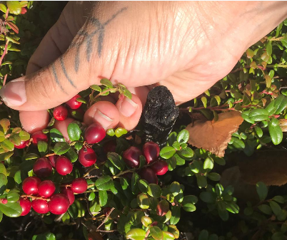
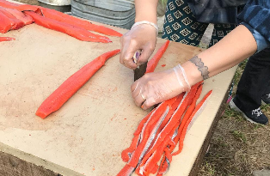
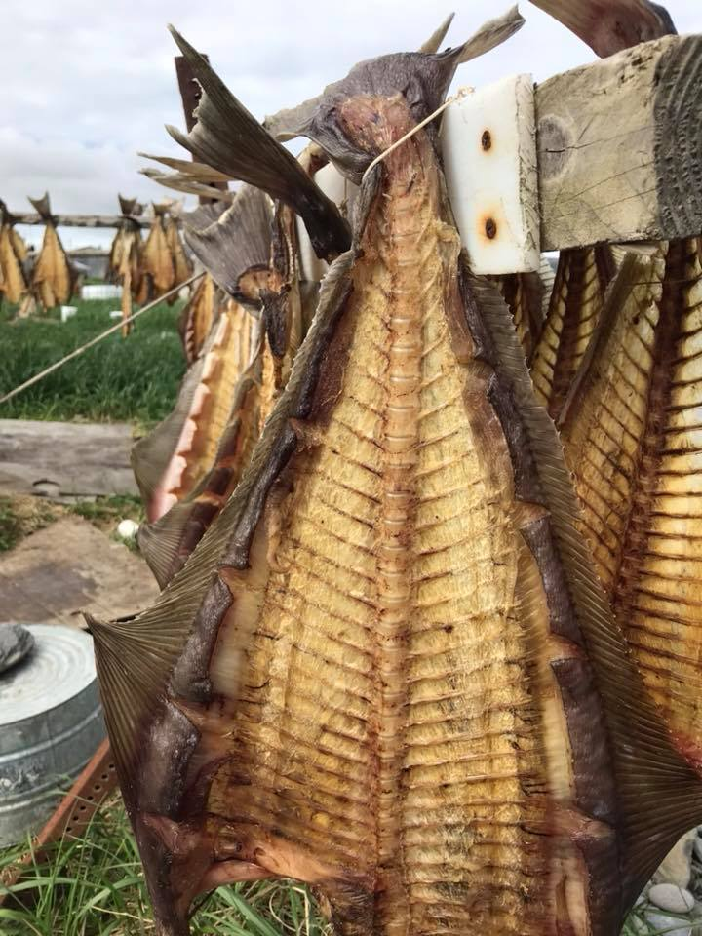
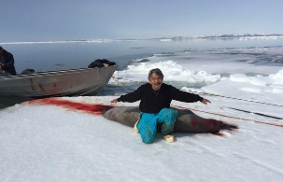
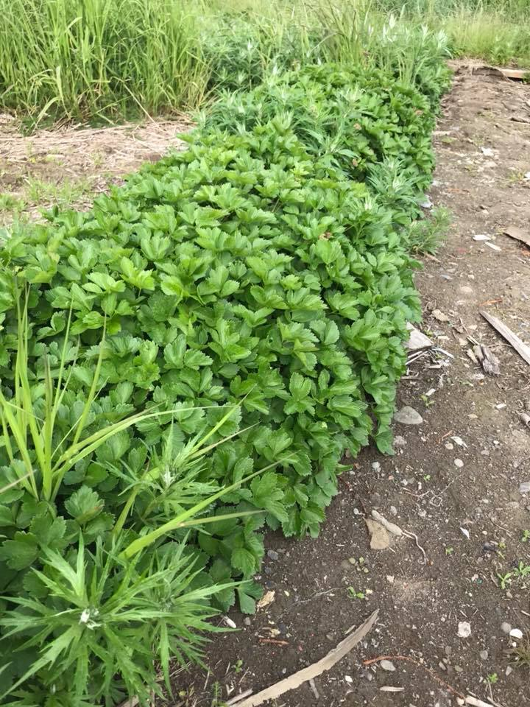
Food Security~Subsistence Foods

Slide 6
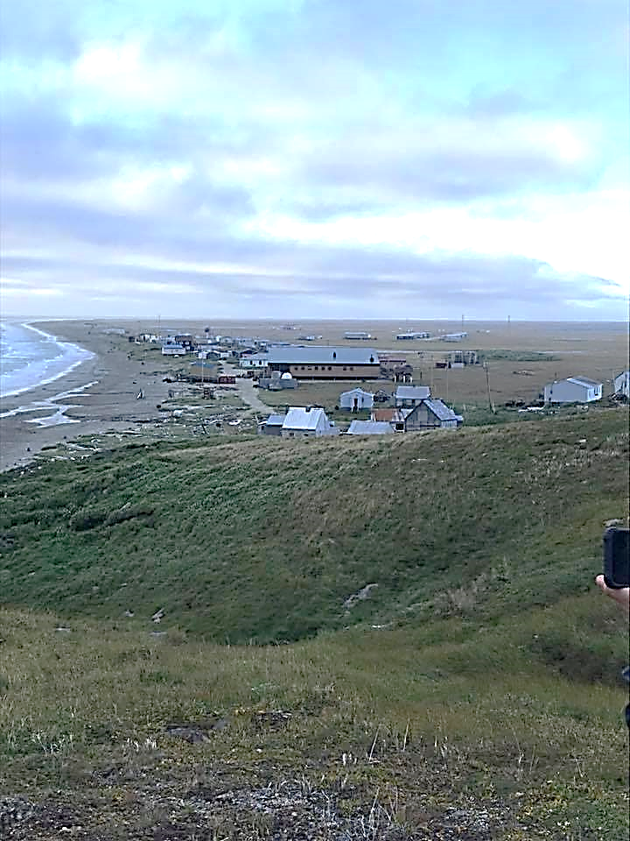
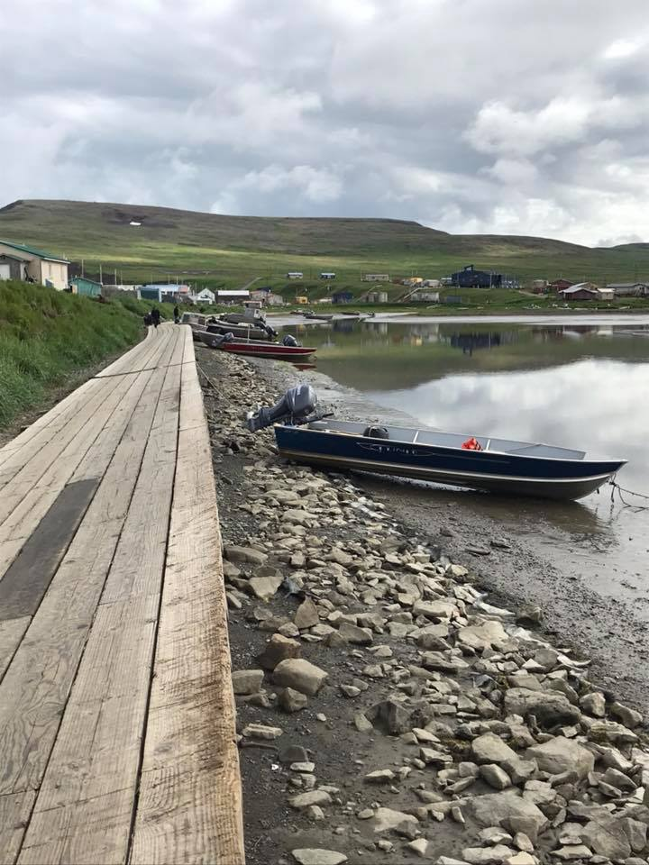
Impacts to Way of Life

Slide 7
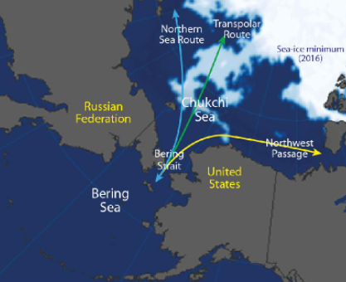
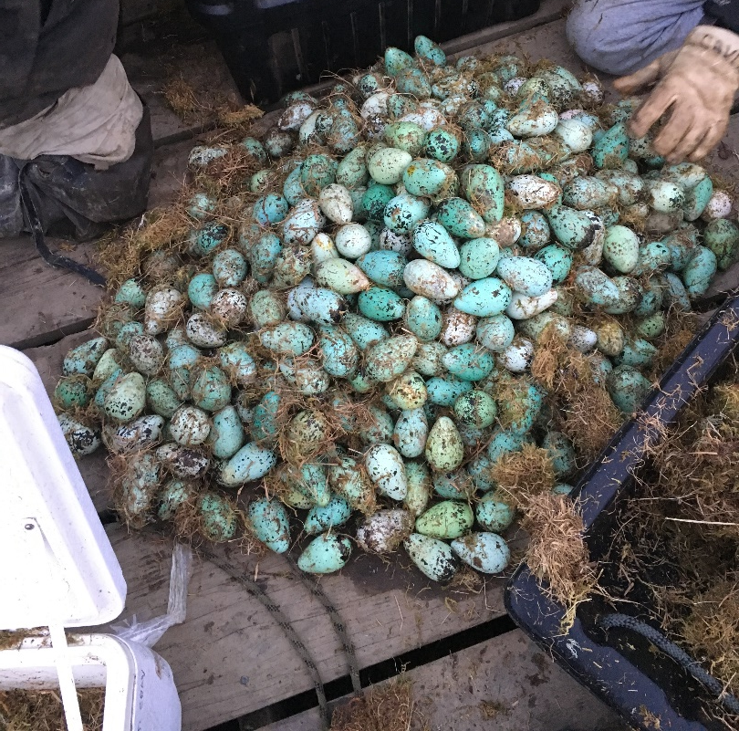
Impacts to Way of Life

Slide 8
Quyanaqpak!
Maktuayaq (Inupiaq)
Mellisa Johnson
Executive Director
Bering Sea Elders Group
P.O. Box 240943
Anchorage, Alaska 99524-0943
beringsea.elders@gmail.com
907-891-1229

