Slide 1
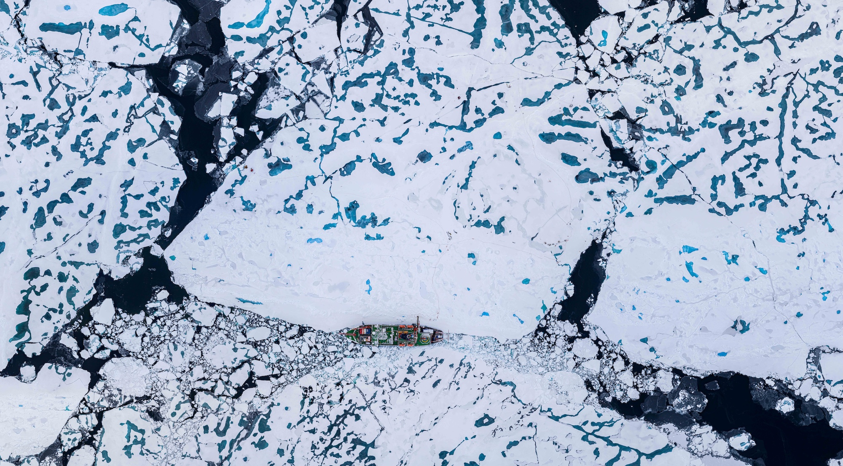
Arctic Shipping and Black Carbon:
Cascading Impacts and Global Implications

Slide 2
What Is Black Carbon?
Arises from incomplete combustion
Extremely small, dark particles (<PM2.5)
Extremely lightweight, if lofted into high atmosphere (for example, from wildfires) can travel great distances
More often, deposits (lands) very close to source
Generally warms when airborne, but most intense warming occurs when over reflective surface such as snow and ice
Most intense warming occurs when deposits on snow and ice

Slide 3
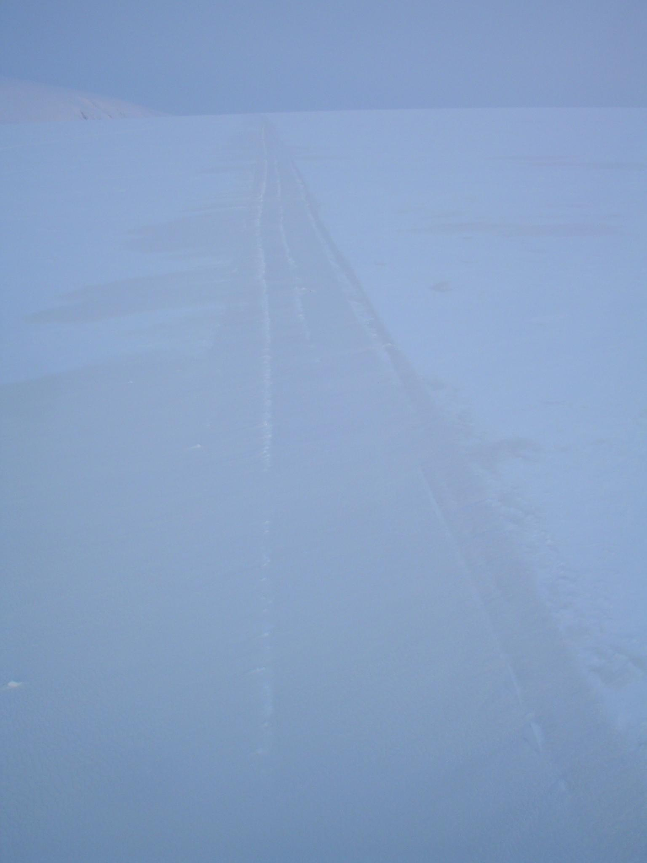
Black Carbon: Small Particles, Visually Subtle
Snowmobile track
←
Polluted
snow
Stohl et al., ACP, 2007

Slide 4
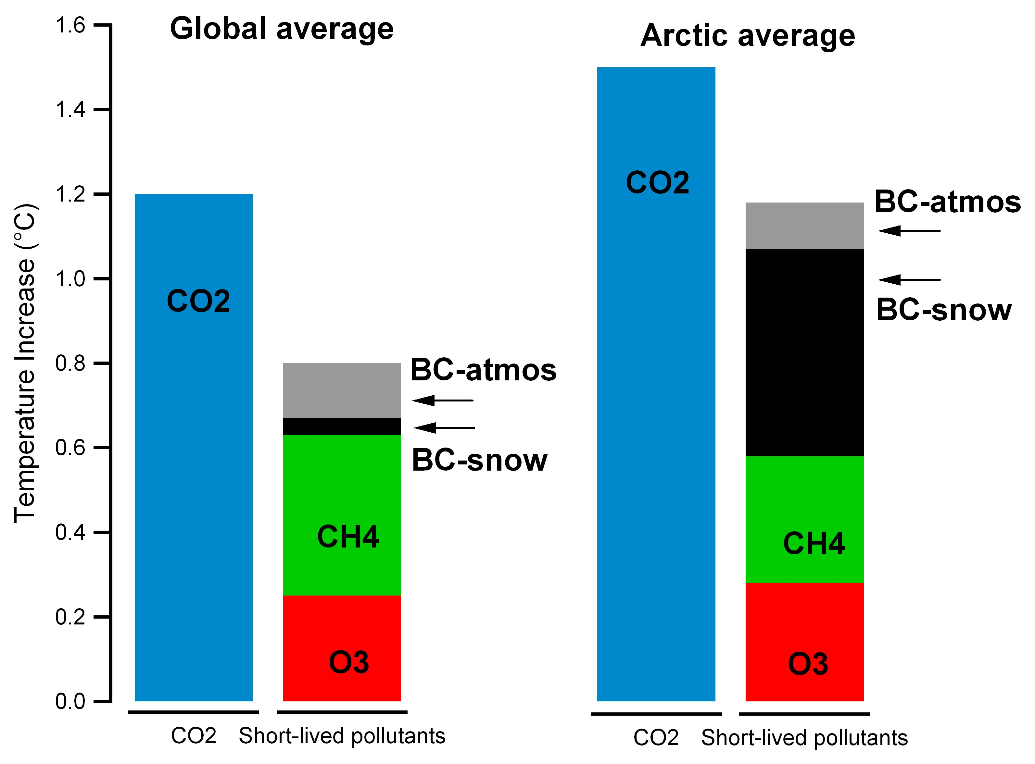
Deposited Black Carbon: Larger Arctic Impact
Quinn, Impact of Short-Lived Pollutants on Arctic Climate, presented at
AMAP, Oslo, September 15 2008
4
Notes:
Bars show the sources (CO2, black carbon both deposited and atmospheric, methane and ozone) of historic warming in the Arctic, similar proportion likely in Andes and other regions but have not been specifically studied.

Slide 5
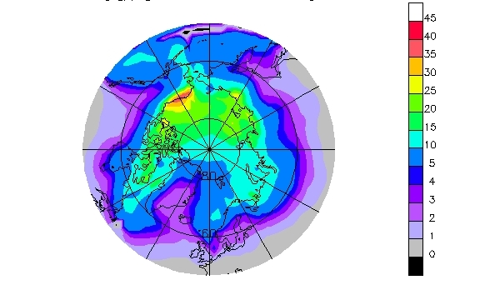
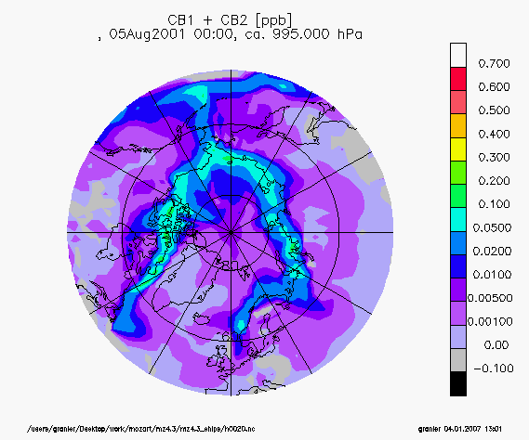
Increased Shipping Brings More Warming from BC/Ozone to Arctic = Greater Ice Loss
Potential surface ozone increase, by 2050 from shipping
Potential black carbon increase, by 2050 from shipping
Granier CATF/GISS Arctic workshop, January 7, 2007, NYC
In-Arctic Shipping Likely the Single Most Effective “Delivery System” for Black Carbon Impacts on Arctic Sea Ice, Arctic Climate and Globally
Notes:
Have linked shipping emissions experts – Drs. James Corbett and Jamie Winebrake -- with AMSA chapter on Environmental Impacts.
Shipping emissions assumptions are driven by Veronika Eyring (JGR 2005) estimates of an increase of 5.3 Tg N/year through 2050. Granier apportions 25% of the emissions increases to newly opened Arctic routes.

Slide 6
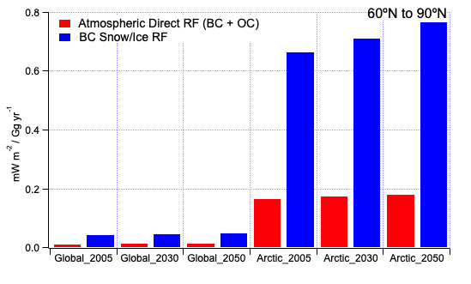
Normalized Atmospheric Direct RF (BC + OC) and BC-Snow/Ice RF due to Projected Increases in Global and Within-Arctic Shipping Emissions (Model:NCAR CCSM)
Source: Arctic Council/AMAP SLF Task Force Final Report, 2011
RF=Radiative Forcing (climate warming impact)

Slide 7
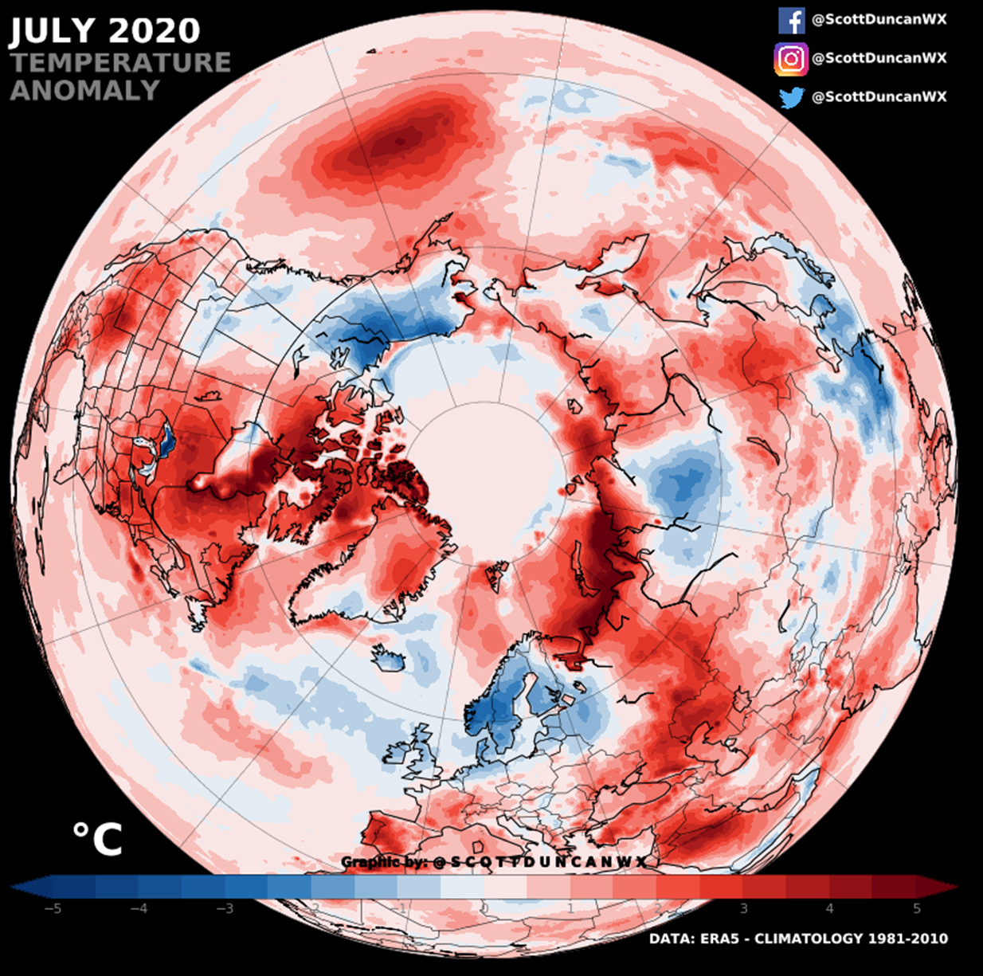
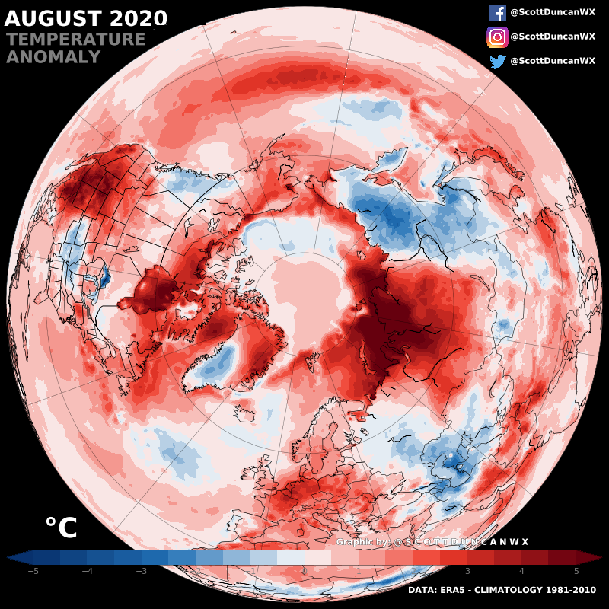
Temperature records in the Arctic
-5 | -4 | -3 | -2 | -1 | 0 | 1 | 2 | 3 | 4 | 5
-5 | -4 | -3 | -2 | -1 | 0 | 1 | 2 | 3 | 4 | 5

Slide 8
Arctic Feedbacks:
Loss of Reflective Ice/Snow Increases Arctic and GMT, Associated with:
Arctic Ocean/northern Seas acidification/freshening/eutrophifcation = fisheries collapse
Slowing of AMOC
Disturbance of mid-latitude weather patterns
Permafrost Thaw and Emissions (>200 years duration)
SLR from Greenland Ice Sheet and Arctic Glaciers (2-7+m)
IPCC SROCC (2019): All of above observed/in progress already at today’s 1.1°C

Slide 9
Working on Arctic Black Carbon:
Arctic Council
  Two Expert Groups: Policy (Iceland chair), Science (U.S.+Finland Co-chairs)
  2017 Ministerial Commitment to 25-33% Reduction by 2025
LRTAP Convention/UNECE/Gothenburg Protocol
  2012: Black carbon included as constituent of PM2.5
Climate and Clean Air Coalition/UNEP
  Transport Initiative (ICCT Lead on Shipping)

